Slide 1


MSA PROJECT
PPT
Implementation of 3-Axis Capacitive Accelerometer using COMSOL Multiphysics

Slide 2
Outline
Problem Statement
Introduction
Types of Accelerometers
Motivation
Working Principle
Brief results and explanation
Conclusion
Team Contribution

Slide 3
Introduction
Accelerometer is an electromechanical device that measures change in velocity or force of acceleration caused by gravity or movement over time.
Most of them are Micro - Electro - Mechanical-Sensors (MEMS) devices.

Slide 4
Problem Statement
Designing and Analysing a MEMS-based Capacitive Accelerometer (3Dimensional)

Slide 5
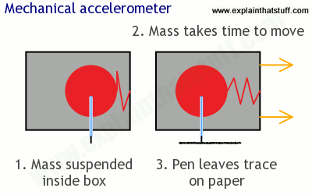
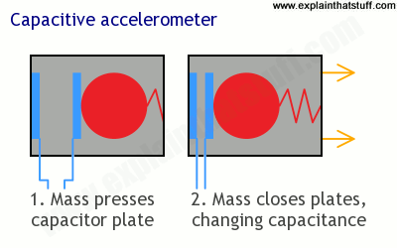
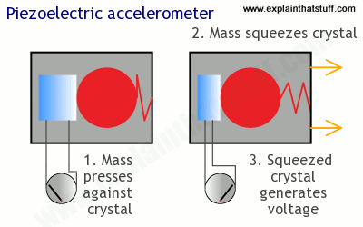
Types of
Accelerometer
Piezoelectric Sensor
Acceleration applied on sensor deforms the crystal.
It is directly proportional to the force.
Piezoresistive Sensor
Change in mechanical stress results in change of material resistivity.
Capacitive Sensor
Senses the displacement of proof mass.
Gives output voltage that is dependent on the distance between the two capacitive plates.
Accuracy and stability are the important features.
Piezoresistive
Capacitive
Piezoelectric

Slide 6
Motivation
One of the earliest forms of accelerometers are Piezoresistive accelerometers . They have high SNR ratio and high durability.
However it has drawback in the following aspects:
They need to be powered, making them unsuitable for low battery applications.
They’re also relative expensive
Sensitive to temperature.
Capacitive accelerometers are the suitable choice where cost is the driving factor and accelerations are uniform in automotive applications.

Slide 7
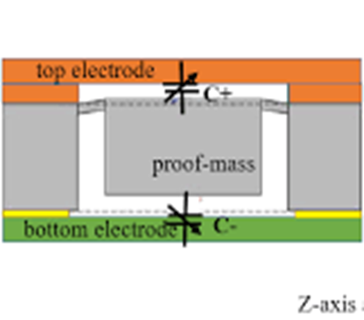
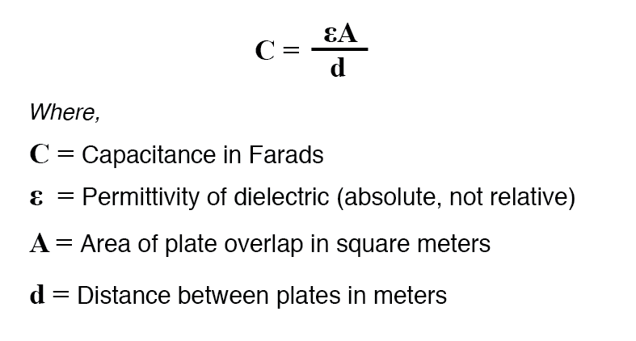
Working Principle
External acceleration displaces the Proof Mass to support frame which increases the stress in the suspension springs.
Measure of the external acceleration.
Relative displacement - change in capacitance between the electrodes.
Suspension beam stress
Hook’s Law
Acceleration→
m
capacitor
spring

Slide 8
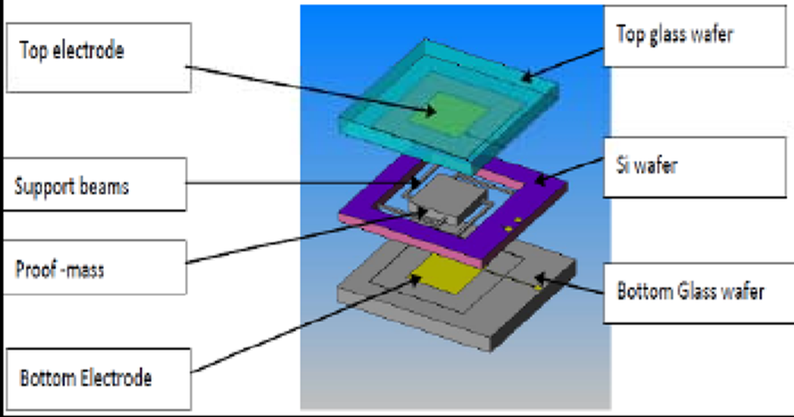
3-axis Capacitive Accelerometer
It is constructed using surface micromachining process.
Measurement of z-axis acceleration is using a differential teeter-totter arrangement.

Slide 9
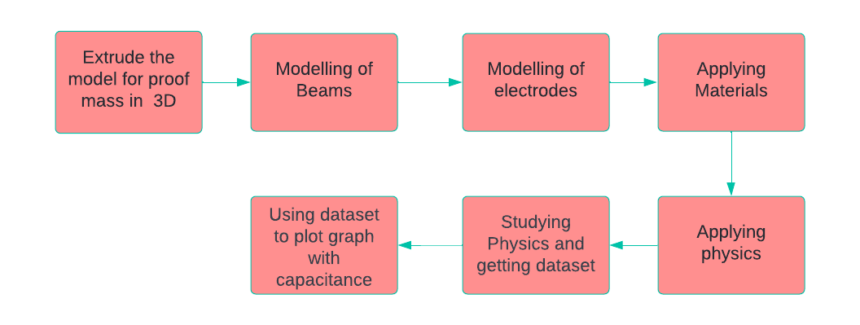
Implementation in COMSOL MULTIPHYSICS
The system equipped with COMSOL Multiphysics is used for the design.
Software is based on advanced numerical methods for modeling and simulation.

Slide 10
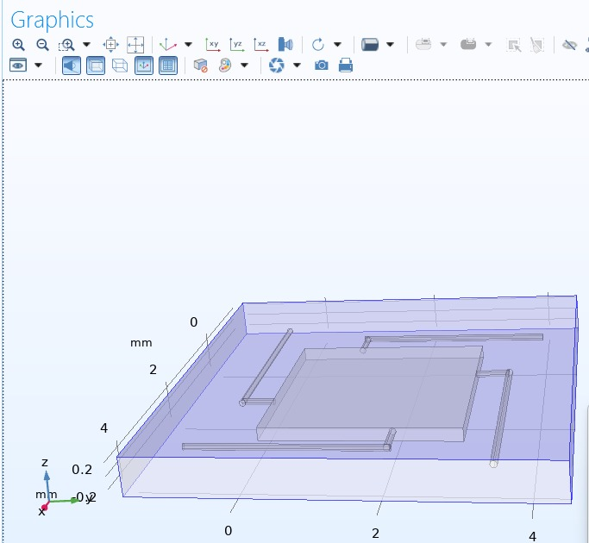
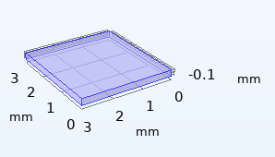
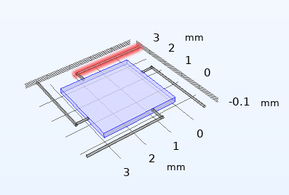
Implementation of the Model in COMSOL Multiphysics
Step 1: Design 2D or 3D geometry, by constructing geometrical shapes as shown below.

Slide 11
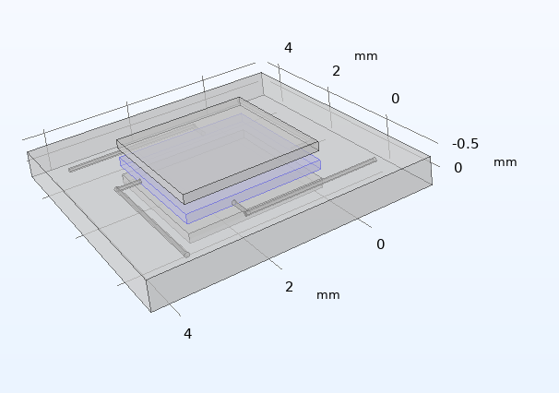
Implementation of the Model in COMSOL Multiphysics
Step 1: Design 2D or 3D geometry, by constructing geometrical shapes as shown below.

Slide 12
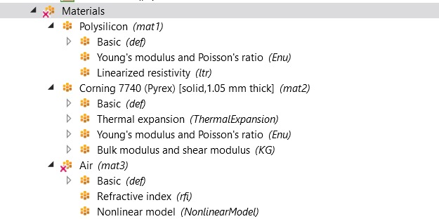
Implementation of the Model in COMSOL Multiphysics
Step 2: The material is selected for the model.

Slide 13
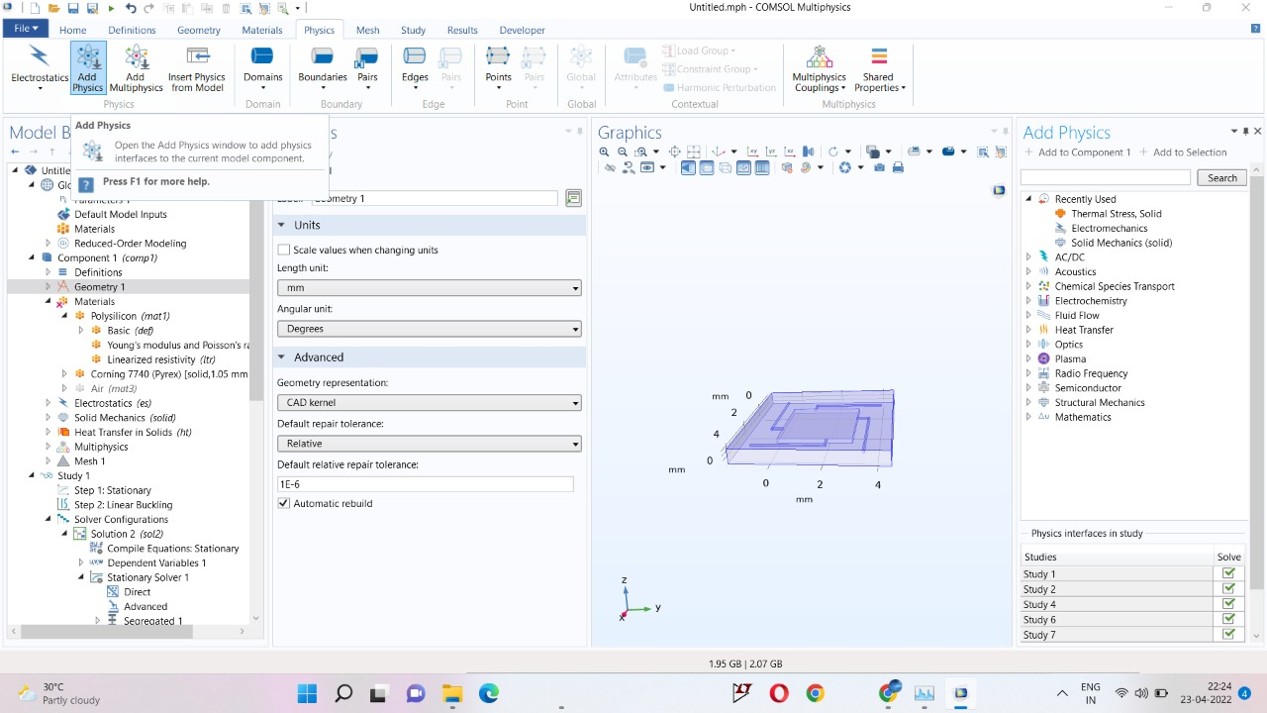
Implementation of the Model in COMSOL Multiphysics
Step 3: The physics for the model is selected.

Slide 14
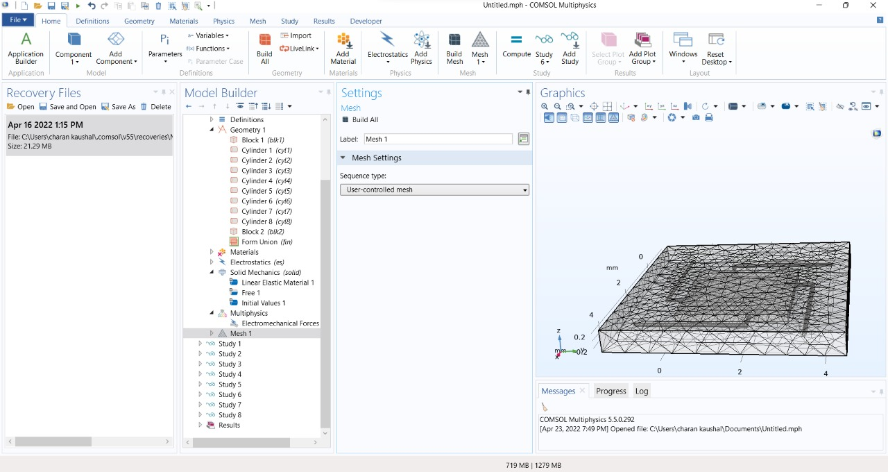
Implementation of the Model in COMSOL Multiphysics
Step 4: Meshing is carried out and solution for the model is obtained.

Slide 15
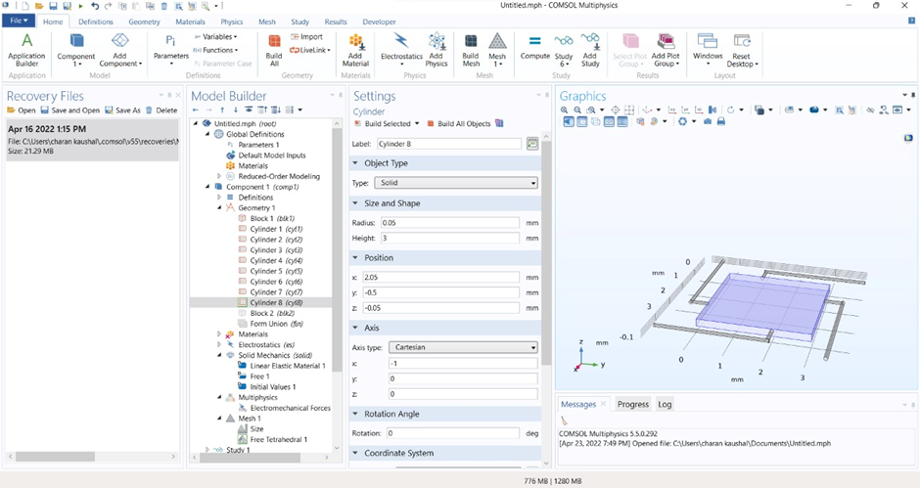
Implementation of the Model in COMSOL Multiphysics
Step 5: The displacement of proof mass is studied.

Slide 16
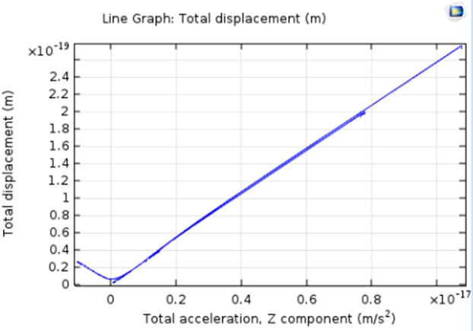
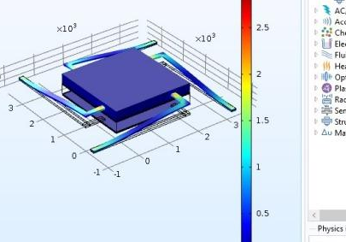
Analysis and Results

Slide 17
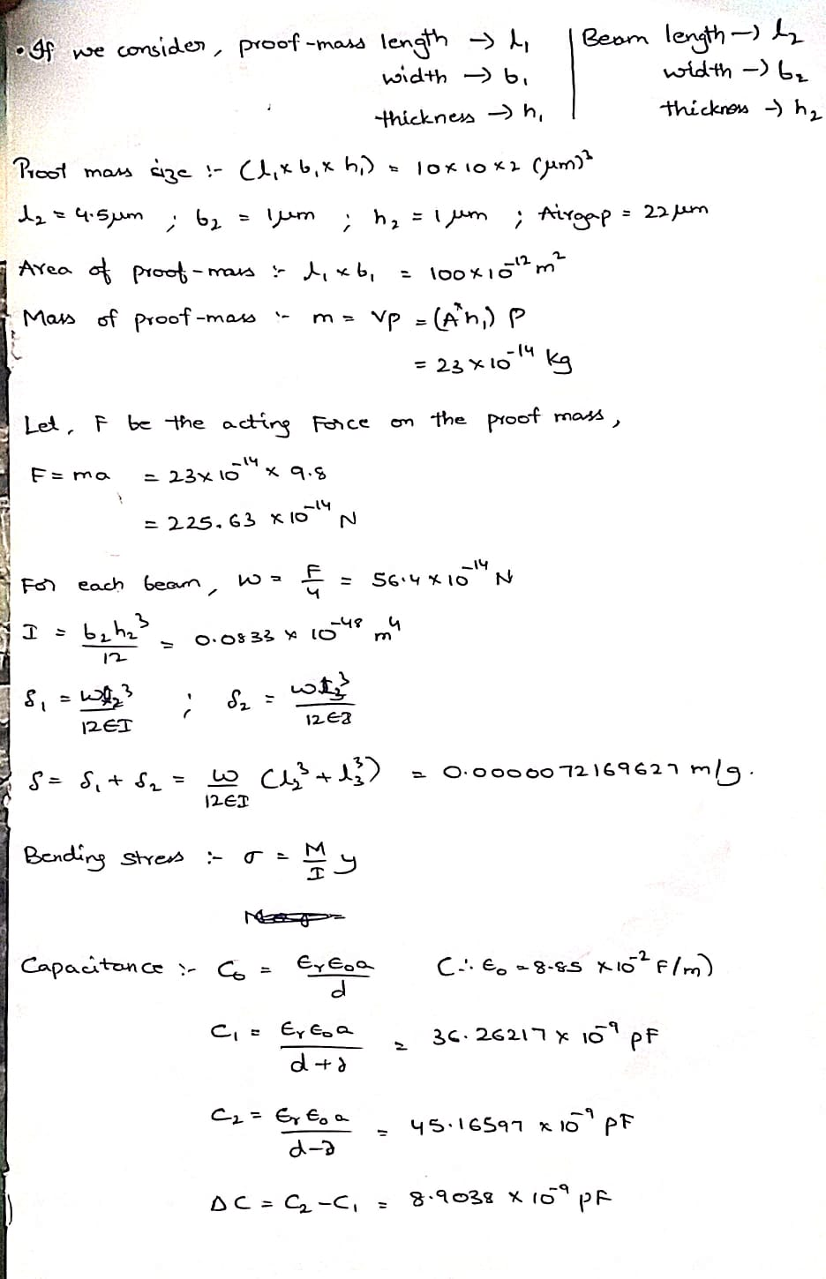
Calculations Involved

Slide 18
Conclusion
The various types of accelerometers and the various materials required in its designing are studied thoroughly.
A 3-axis MEMS capacitive accelerometer is implemented in COMSOL Multiphysics where we are applying the force in the positive z-direction.
The results can be used to calculate the change in distance between the capacitive plates w.r.t change in capacitance which is linear in nature.
This has its applications especially in the biomedical industry where we can use this in pacemakers, eye surgery, kidney dialysis and much more other life-saving operations.

Slide 19
Applications
This has its applications especially in the: -
Biomedical industry where we can use this in pacemakers, eye surgery, kidney dialysis and much more other life-saving operations.
Air bag deployment - Vehicle safety device, Airbag Control Unit(ACU). Accelerometers as inertia sensors in ACU.
Industrial applications, to measure platform stability or tilt on which machines are placed.

Slide 20
References
Neuzil, P., Yong Liu, Han-Hua Feng and Wenjiang Zeng (2005). Mi-cromachined bolometer with single-crystal silicon diode as temperaturesensor. IEEE Electron Device Letters, 26(5), pp.320-322.
N, D., V, J. and Kumar B, R. (2015). Design and Simulation of MEMSAccelerometer Using COMSOL Multiphysics Software. International Journal of Engineering Trends and Technology, 20(5), pp.244-247.
A. Jadhav, T. Agarkar and S. Kodagali, ”Advanced real time high performance time based 3 axis capacitive accelerometer”, International Conference by ISTE, ISBN. 978-93-86171-02-3, 2017.
Matsumoto, Y., Iwakiri, M., Tanaka, H., Ishida, M. and Nakamura, T.(1996). A capacitive accelerometer using SDB-SOI structure. Sensors and Actuators A: Physical, 53(1-3), pp.267-272.
MacDonald, G. (1990). A review of low cost accelerometers for vehicledynamics. Sensors and Actuators A: Physical, 21(1-3), pp.303-307.
Chen, H., Bao, M., Zhu, H. and Shen, S. (1997). A piezoresistive ac-celerometer with a novel vertical beam structure. Sensors and Actuators A: Physical, 63(1), pp.19-25.
Kavitha, S., Joseph Daniel, R. and Sumangala, K. (2016). Design andAnalysis of MEMS Comb Drive Capacitive Accelerometer for SHMand Seismic Applications. Measurement, 93, pp.327-339.

Slide 21
Team Contributions
Subash J - Design Model and Simulation
Jnaneswar S - Design Model and Simulation
Sriram R.V.S.S - Analysis and Results
Charan Kaushal S - Understanding Theory and Report

Slide 22
Thank you
GROUP MEMBERS:
Subash J - S20190020253
S. Charan Kaushal - S20190020249
S.S.S. Jnaneswar -S20190020252
R.V.S.S Sriram - S20190020246

